Slide 1

Flux National Steerco
Meeting Report - 14 April 2018

Slide 2
Steerco Meeting #0
Agenda
Call to order & welcome
Opening words - Nathan & Max
Introductions
Objectives of Steerco
Working Groups
Local Branches (State / Federal)
Priorities
Attendees / Role
Nathan Spataro - Leader (NS)
Max Kaye - Deputy Leader (MK)
Daithí Ó Gliasáin - Chair (DG)
Riley Kinnunen - Secretary (RK)
Ben Rushton - Treasurer (BR)
Alison Brewer - Steerco member (AB
Rhys Alconly-Jones - Steerco member (RA)

Slide 3
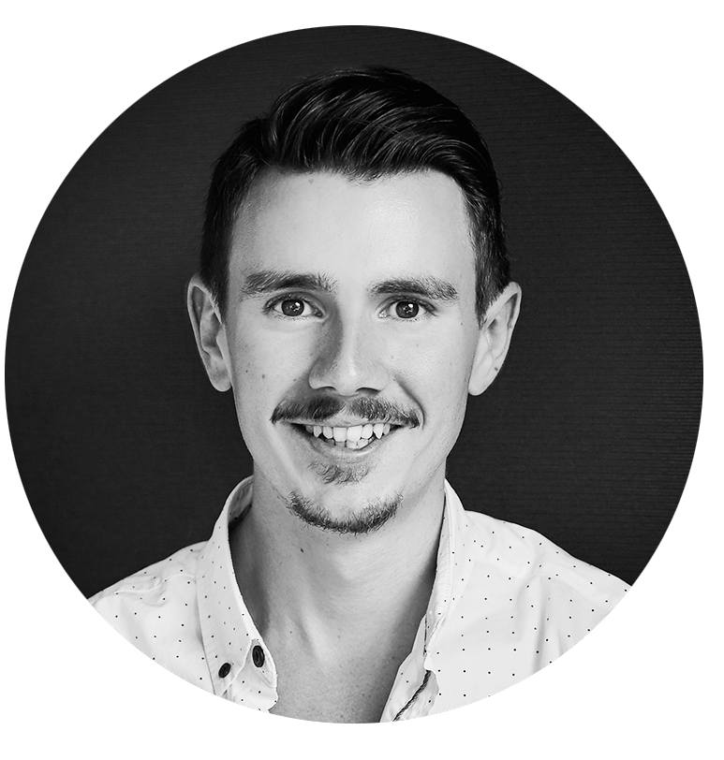
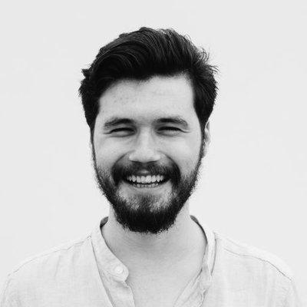
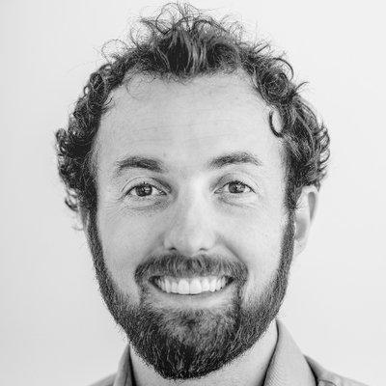
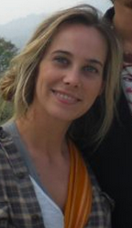
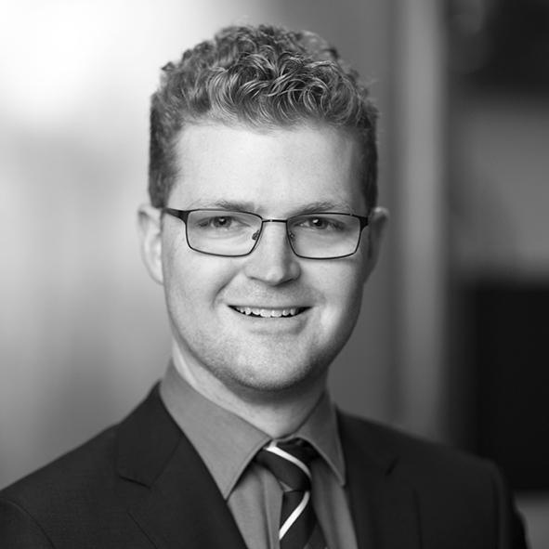
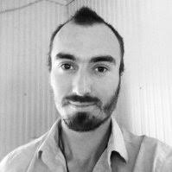
Introductions
Nathan Spataro
Leader
Daithí Ó Gliasáin
Chair
Ben Rushton
Treasurer
Rhys Aconley- Jones
Steerco Member
Max Kaye
Deputy Leader
Riley Kinnunen
Secretary
Alison Brewer
Steerco Member

Slide 4
Objectives of Steerco
Accountability
Holding ourselves to account to get things done
Alignment
Cooperate effectively across the nation
Communication & coordination
Develop & share the big picture
Strategic guidance
Holistic vision / tangible outcomes / focused application
Decision-making
Transparent & accountable decisions as required

Slide 5
Strategic Objectives
Make IBDD Famous
Enhance Flux as an Organisation
Develop the membership base
Compete in Election Campaigns

Slide 6
Actions
Next meeting: Flux National Steerco Kick-off Official - May 6th 2018
# | Description | Due | Assigned to
1 | Strategy document & Steerco Comms | Next steerco meeting | DG
2 | Working Groups |  | RK
3 | State Branch Representatives for Steerco |  | NS
4 | Organisation technology |  | MK
5 | Governance |  | NS / RA
6 | Finances / fundraising / platforms / structure |  | BR / RK / MK

Slide 7
Appendix
Introductions
Strategy draft

Slide 8
Introductions
Nathan Spataro
Leader
Nathan is an ardent and outspoken proponent of free speech, civil liberties, and human rights. His educational background is in government, international relations, and philosophy. He has campaigned in previous elections for minor parties.
Nathan's work background is in sales and IT, but has more recently become passionate about blockchain technology and its impact on the future of politics. Nathan believes in a free and open society that places a high value on healthy criticism and debate. He is excited that ordinary Australians could one day play a much greater part in their country’s political future.
Max Kaye
Deputy Leader
Max is passionate about improving the world. He is a software developer and blockchain consultant. His educational background is in science, mathematics, and information systems, and has a lifelong interest in economics, political philosophy, disruptive startups, and theory of knowledge.
Max sees immense scope for technology to empower ordinary people to properly participate in their democracy. He knows there's a better way of doing things. He prefers to use the oxford comma.

Slide 9
Introductions
Daithí Ó Gliasáin
Chair
Daithí managed the Flux WA state campaign in 2017, having previously worked on political campaigns in Ireland & Australia.
He works as a consultant advising organisations on strategy, culture, and technology implementation.
He is passionate about good governance and enhancing the conversation on issues in society.
He is most interested in helping Flux sustainably scale for the long road ahead.
Riley Kinnunen
Secretary
Riley joined Flux in July 2017 after spending some time considering the possibilities of new democratic forms given modern technology. She has a background in political philosophy with a focus on democratic foundations.
Riley initiated the Flux Queensland branch and, with the Qld Steer Co, registered the party in December 2017. Her strengths include policy, procedure and process development with due consideration for the fiduciary duties of the party.
Her intellectual interest involves collaborating on the design of the Flux liquid democracy platform, formalizing the Flux Wiki and facilitating academic criticism.

Slide 10
Introductions
Ben Rushton
Treasurer
Ben….
Alison Brewer
Steerco Member
Alison developed her career and skills within the Public Service (Dept. of Justice & Dept. of Education in WA), and working in a research capacity for Edith Cowan University.
She has a degree in psychology and a minor in management, and places a strong emphasis on critical thinking. She believes in using a diplomatic and friendly approach that results in effective communication. Although she does admit to being randomly distracted by shiny things.
"Based on my career experience, complemented by my areas of study, I believe I can make a valuable contribution to the promotion of autonomy, purpose and expertise as a means to deliver excellent policy. I can think of nothing more inspiring than the opportunity to ‘dismantle political apathy, by empowering the disenfranchised, and motivating a new generation of innovative Australians to take responsibility for their society’ (from Flux Vision and Purpose).

Slide 11
Introductions
Rhys Aconley- Jones
Steerco Member
Rhys is an accredited mediator with a background in law and a focus on quality relationships. He is passionate about interpersonal justice and strengthening the ties that bind us through deliberative and inclusive processes.
He has recently returned from remote Central Australia, where he was coordinating an indigenous mediation and justice program, and is currently working with organisations to communicate more effectively across all levels of decision-making.
Rhys has held positions as a researcher and academic, as well as a grass-roots community facilitator, and is excited to be working towards the realisation of Issues Based Direct Democracy.

Slide 12
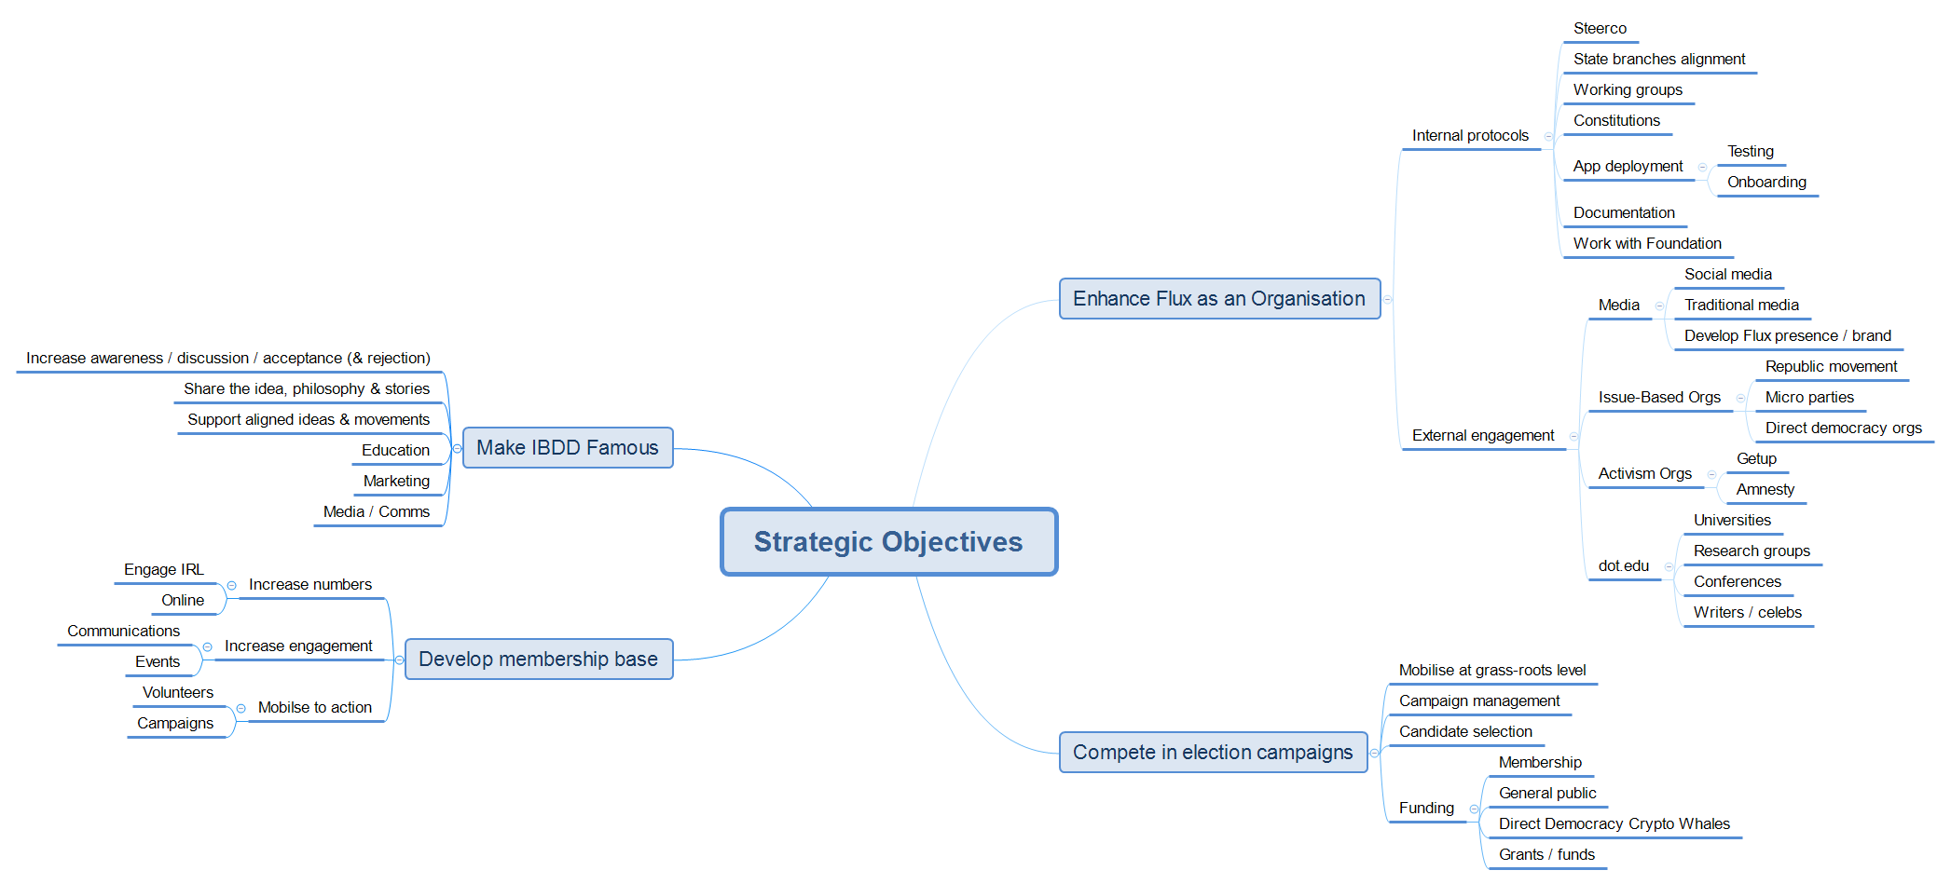
Strategy draft

Slide 13
docs.flux.party
voteflux.org

